Slide 1

TeAm DynAmite
Tenisha Thompson Scrum Master Week 4

Slide 2
Final Project Requirements
Meeting Dates and Time
Scrum
Resources for data Wrangling

Slide 3

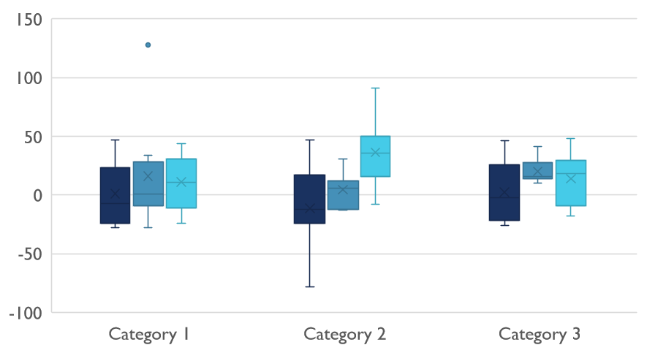
Current Progress

Slide 4
Current Progress
Last Weeks Goals
This Weeks Goals
Impediments(Self/Project)
Identify
Improve
Remove
Notes:
Self
My attention to trello board task
Struggling to check progress and not be overwhelmed with lack of usable datasets
Reaching out to Mentors for additional guidance.
Project
Lack of usable datasets
Not much wrangling in Python or R Studio

Slide 5

Digital Communications
Slack
Github
Trello

Slide 6
Data Visualization
Tableau
Python
R Studio

Slide 7
DSO Resources
Module 105C
Module 106C
Module 104C
Woz Final Project Recordings
Notes:
Use intermediate statistics for data visualization
What is out categorical search
Give proof to the cocept
Bayes Linear Regression kdnuggets.com/2019/06/5-ways-lack-data-machine-learning.html
Tenisha Thompson is inviting you to a scheduled Zoom meeting.
Topic: Tenisha Thompson's Personal Meeting Room
Join Zoom Meeting
https://cccedu.zoom.us/j/3276485915
Meeting ID: 327 648 5915
One tap mobile
+13126266799,,3276485915# US (Chicago)
+19292056099,,3276485915# US (New York)
Dial by your location
+1 312 626 6799 US (Chicago)
+1 929 205 6099 US (New York)
+1 301 715 8592 US (Washington DC)
+1 346 248 7799 US (Houston)
+1 669 900 6833 US (San Jose)
+1 253 215 8782 US (Tacoma)
Meeting ID: 327 648 5915
Find your local number: https://cccedu.zoom.us/u/kSKDTsISg
Join by Skype for Business
https://cccedu.zoom.us/skype/3276485915

Slide 8

Thank You
Thompson.tenisha2@gmail.com

